Slide 1


Red Wine Quality Predictors by The Three Musketeers

Slide 2
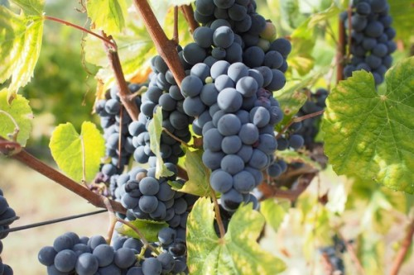
TEAM Introductions

Slide 3

Autumn Heyman
Education
BS Alternative Medicine (Everglades University)
MPH Complementary & Alternative Medicine, Functional Nutrition (Everglades University)
MBA Non-Profit Leadership & Management (Liberty University)
Current Profession
Sole-proprietor facilitating respite, in-home, &community service supports for adults with developmental/intellectual disabilities
Data Science Pursuits
Field research, analyzation, and program development to address turnover, retention, and employment attraction to the field.
Tools to convert field practices into actionable agency policies.
Public policy development and reform.
Favorite Languages
R and Python
Favorite Wine
Malbec

Slide 4
Erin WeaveR
Introducing the Pantone Color of the Year 2022. PANTONE 17-3938 Very Peri is a dynamic hue that blends the faithfulness and constancy of blue with the energy and excitement of red.
The four color palettes in this template feature Very Peri to help you express your ideas and convey the right mood. Read on to learn how to use these colors in any presentation.

Slide 5
Georgia Miller
Army National Guard veteran with a background in Python and GIS
Favorite Language: R
Favorite wine: Merlot

Slide 6
PROJECT INTRODUCTION
Exploring Vinho Verde red wine quality within the Minho region of Portugal

Slide 7
Wine Quality
Subjective
Objective

Slide 8
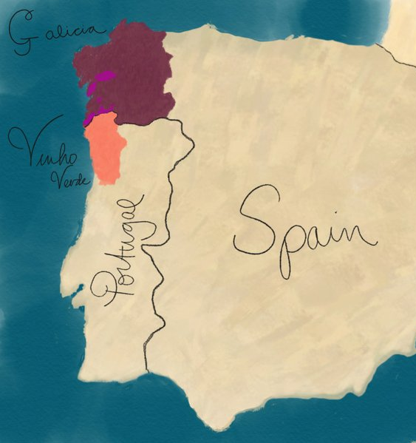
Wine region
Vinho Verde
Alvarinho & Loueiro
Amaral, Borraçal
Galicia
Albariño
Mencía

Slide 9
WINE REGION (continued)
Vinho Verde hails from a small region, Minho, nestled in Northern Portugal.
Minho is particularly known for its bright, summery white wines with subtle carbonation.
Red and rosé Vinho Verde wines are the region's ‘rare gems’.
Cool, rainy climate-> more difficult to ripen the red Vinhão and Padeiro grapes

Slide 10
PROJECT BACKGROUND
Portuguese wine production & exports, their increasing value, their strive for global competition

Slide 11
ProjecT Background: Portuguese wine Production & Exports
Portugal: 5th largest wine producer in Europe, 11th largest in the world
2020: Despite COVID-19 pandemic: Portuguese wine exports ⬆️5% compared to 2019.
306 million liters of wine exported, valued at $936 million
2021: Portuguese wines grew 3.8% (volume), 8.6% (value), 4.6% (average price) from 2020.
Ministry of Agriculture: has honed its focus on monitoring farmers and wine producers.
Why? The increasing value of Portuguese wine, currently in competition with France, the United States, the United Kingdom, Brazil, and Germany
Action Plan: Define & implement measures to guarantee predictability/stability in Portuguese wine production.
Wine certification and quality assessment are key elements within this context.

Slide 12
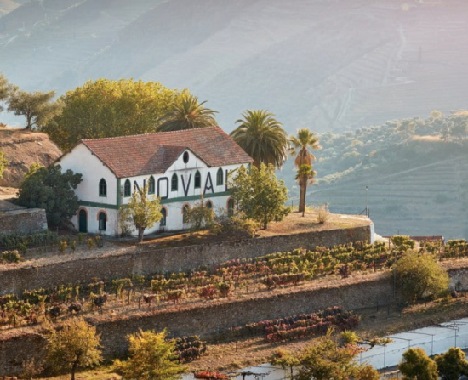
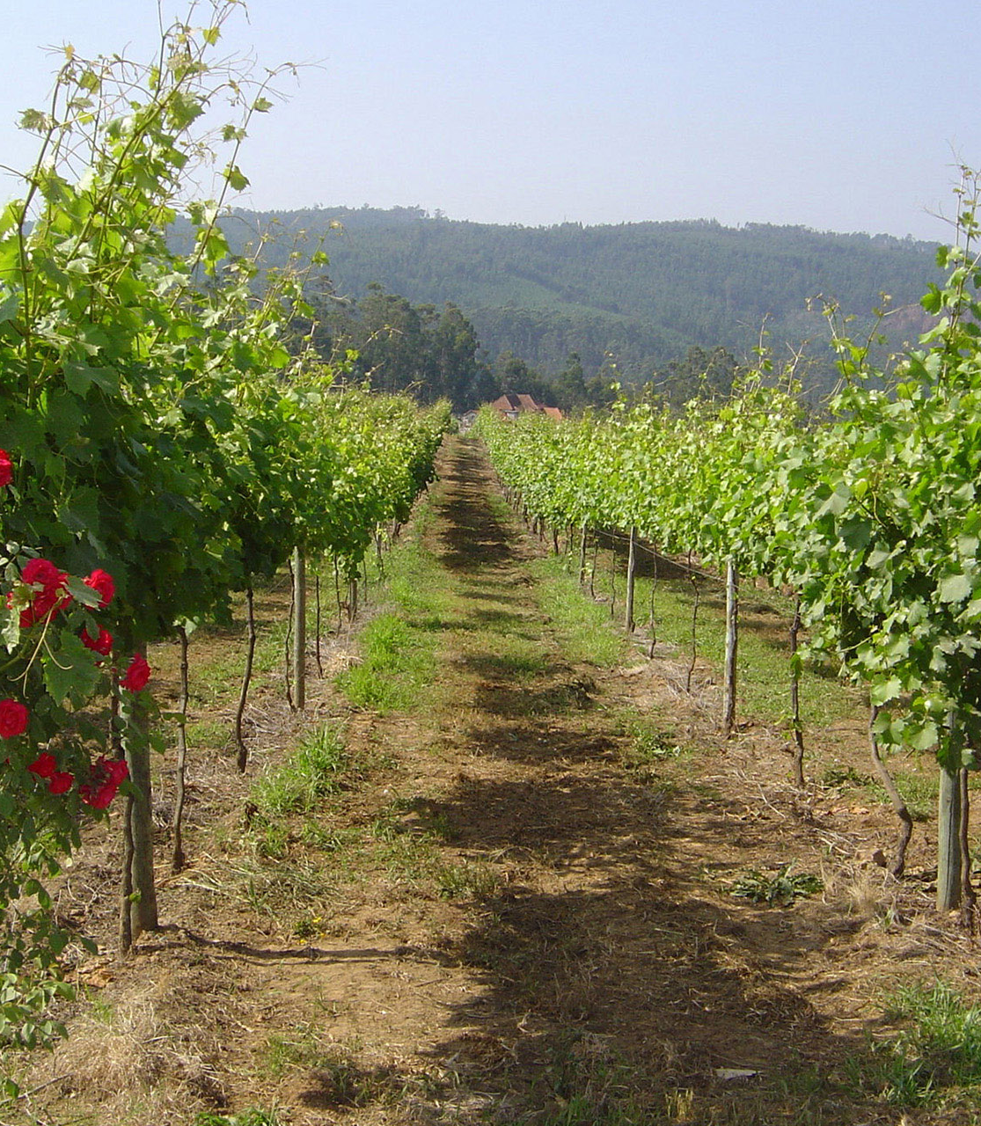
ProjecT Background: PURPOSE
Due to the lack of red wine quality data (Minho region) & regional/global competition initiatives, as data scientists:
We recognize the opportunity for winemakers to:
1. Capitalize on this data: improve decision making processes
2. Bring these ‘rare’ red wines to more tables across the globe.

Slide 13
The DATASET

Slide 14
The DataSet
Original Study: Paulo Cortez, University of Minho, Guimarães, Portugal, http://www3.dsi.uminho.pt/pcortez , A. Cerdeira, F. Almeida, T. Matos and J. Reis, Viticulture Commission of the Vinho Verde Region(CVRVV), Porto, Portugal @2009
Distribution: The original dataset is located on the UCI Machine Learning Repository: https://archive.ics.uci.edu/ml/datasets/wine+quality
Project Dataset Version: M Yasser H. Wine quality dataset. Kaggle: https://www.kaggle.com/datasets/yasserh/wine-quality-dataset

Slide 15
The DataSet
Quality score was determined by:
Scale: 3-4(poor), 5-6(average), 7-8(good)

Slide 16
EVALUATION QUESTIONS & METHODS

Slide 17
Questions
Which physiochemical properties of wine have the greatest impact on wine quality?
What ratio of the properties selected cause the quality to differentiate from poor/average/good?

Slide 18
METHODS
Wrangle data / Recode quality
Tried stepwise binary logistic regression, results messy
Ordinal Logistic Regression / Confusion matrix
Second half:
Tried KMeans with original analysis
Went with LDA with other first analysis

Slide 19
METHODS
You also want to paint a picture of what your data is like. Include details such as:
Density, Chlorides, Volatile Acidity, & pH top variables
1599 cases, which will further reduce to 1143 cases once the data is cleaned and wrangled
The methods section should only be a few slides, and should not include any code. You are presenting to a wide, non-data science audience, and thus should not go into a lot of detail.

Slide 20
RESULTS

Slide 21
Results
The results section will be the meat of your presentation. You should divide your results section into parts by evaluation question, so that you can easily signpost things. In the results section, you will go over any of the exploratory findings you have you want discuss, as well as the answers to each evaluation question. Ensure that you provide LOTS of beautiful visuals to go along with your findings.

Slide 22
SUMMARY & CONCLUSIONS

Slide 23
Summary
The summary should be JUST ONE SLIDE, and it should contain a summary of the entirety of your results section. It should be in layman's terms, quick and dirty.

Slide 24
Conclusions
Your conclusion section should also only be one slide long. In it, you should have some bullet points containing information about:
How do your findings impact the world at large?
What's important about this work?
Big picture information

Slide 25
QUESTIONS ?

Slide 26



